Slide 1
CSE PROJECT
INTERNATIONAL ISLAMIC UNIVERSITY CHITTAGONG

Slide 2
PRESENTATION
Poject name : A Hardware shop’s sales database
OVERVIEW:
This software keeps data of all sales in a file.It stores all the information of the hardware which are sold.User has to give user name and passoword for accessing this software.After that they can use the software .There is a menu with a lots of hardware name and a few feature like viewing sales report,searching item by a unique code,deleting all record.

Slide 3
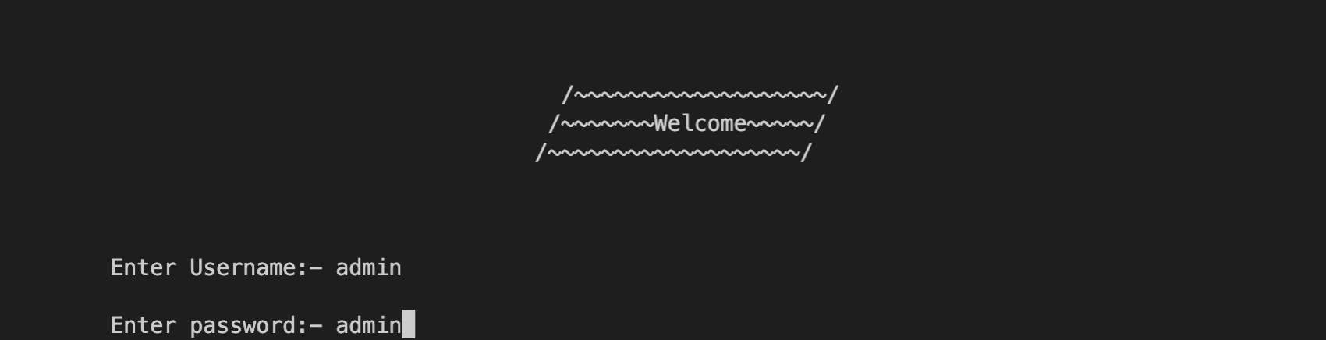
This is the welcome menu of this software
The user has to give username and password to access further
If the Username and password is correct then it will go to main menu.
If the Username and password is incorrect then the program will stop

Slide 4
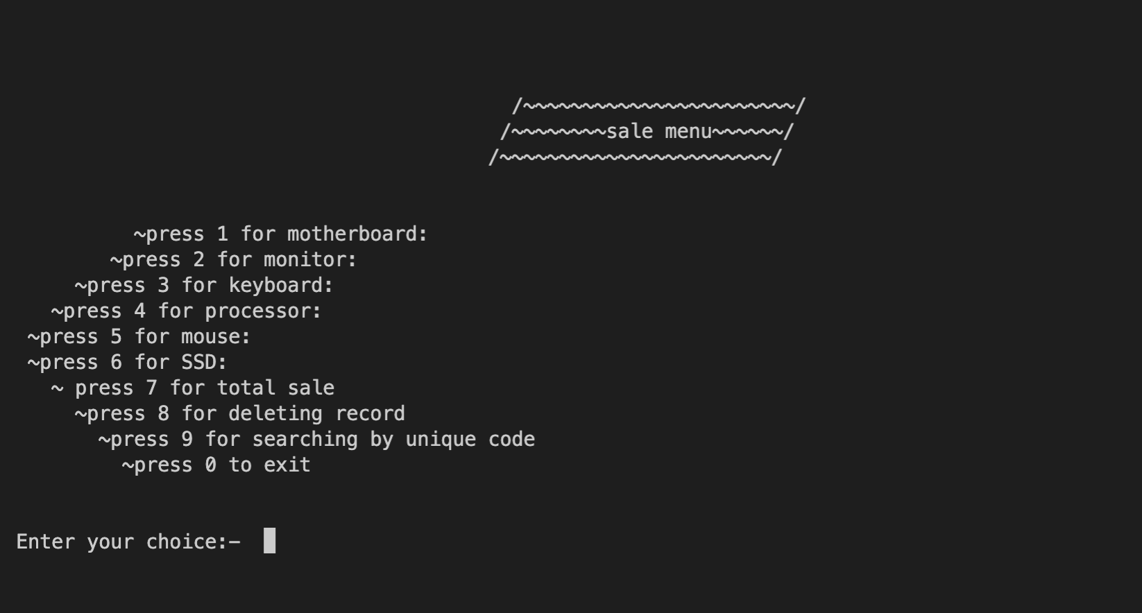
Main menu
This is the main menu
There are 6 hardware item available . By pressing user can store the information of of the hardware which are being sold.
Total sale menu shows all the report off the sold software,the deleting recond menu delets all the record.
The searching by unique code cheeks if the Hardware was sold from their shop or not .Every hardware gets a unique code from user at the time of input.

Slide 5
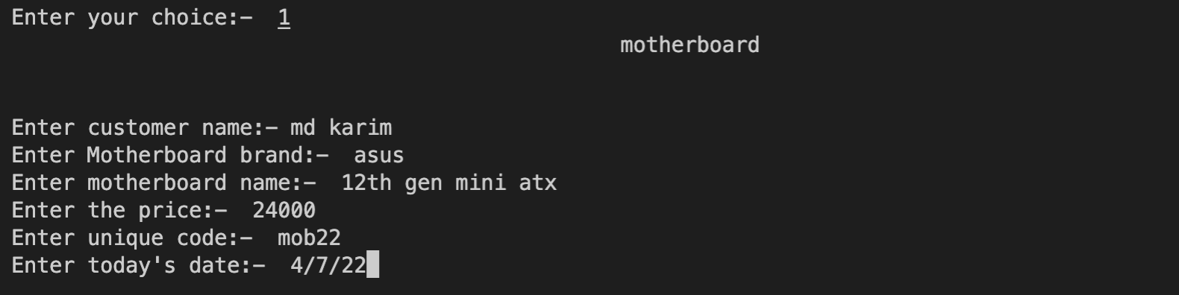
Input menu of hardware
This is the input menu of every hardware. User has to fillup all the information for selling a Hardware
User has to input customer name, Hardware brand, Hardware name, Price, a unique code and the date of that day.

Slide 6
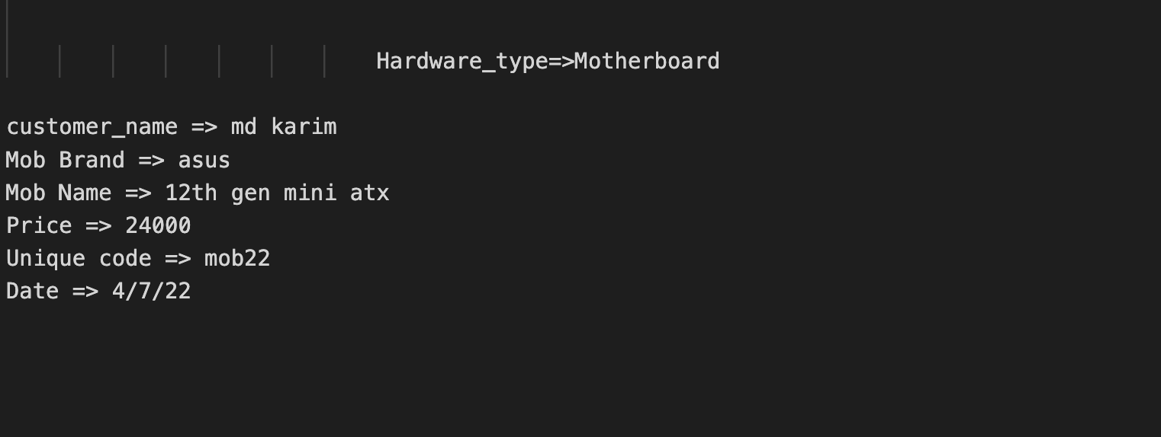
Storing in File
This is how all of information of a Hardware stores on the file.

Slide 7
Benefit of the software
This software is very helpful for a hardware shop for keeping sales report of the Hardwares.
This software saves time and effort.
User can easily see all the record of the software that are sold.
In case of any problem user can cheek if the hardware was sold form their shop or not by the help of unique code.
This software is secured user has to input user name and password for accessing the main menu.

